Slide 1
Capstone Project - The Battle of Neighborhoods
Ferretti Chiara Final Assignment

Slide 2
1. Introduction
The aim of this analysis is to find the perfect spot to open a restaurant in Turin, a city in northern Italy.
Turin is the Chief Town of Piemonte Region, and the former Capital City of Italy. It is very important both for industrial context and for tourism.
Therefore, the audience of this study are stakeholders interested in opening a new restaurant in Turin.

Slide 3
2. Data
Data on Boroughs (called "Municipalities"), Neighbourhoods and their coordinates is needed.
A list of Turin's Boroughs and Neighbourhoods can be find at the following link: https://it.wikipedia.org/wiki/Circoscrizioni_di_Torino
On the contrary, coordinates of every neighborhood can be collected from the following site: https://www.gps-coordinates.net/

Slide 4
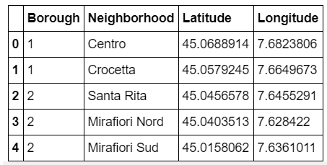
2. Data
These pieces of information have been gathered together and put in a table.
The image below shows first 5 rows of the table:

Slide 5
3. Methodology
The total number of neighborhoods in Turin are 35.
So, we need to find a way to cluster them based on their similarities, that are the number and the kind of venues.
In order to do this, a Foursquare API will be used to explore the neighborhoods.
Then, a K-Means algorithm will be used to extract the clusters, afterwards they will be examined to find the best neighborood to open a restaurant in Turin.

Slide 6
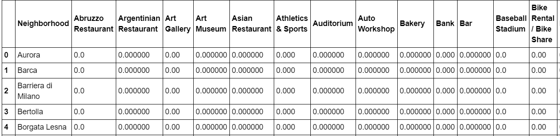
4. Results
In Turin there are 590 venues and they can be gathered in 144 categories.
Rows of the dataframe have been grouped by neighborhood and by taking the mean of the frequency of occurrence of each category.
Image below shows first 5 rows and 15 columns of the table:

Slide 7
4. Results
It has been shown each neighborhood along with the top 10 most common venues.
Then, neighborhoods have been clustered in 5 clusters (k-means algorithm).

Slide 8
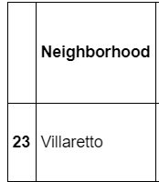
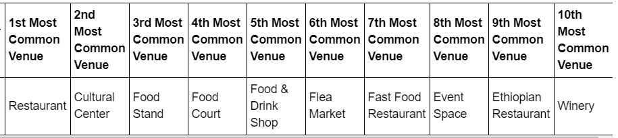
4. Results
Cluster 1

Slide 9
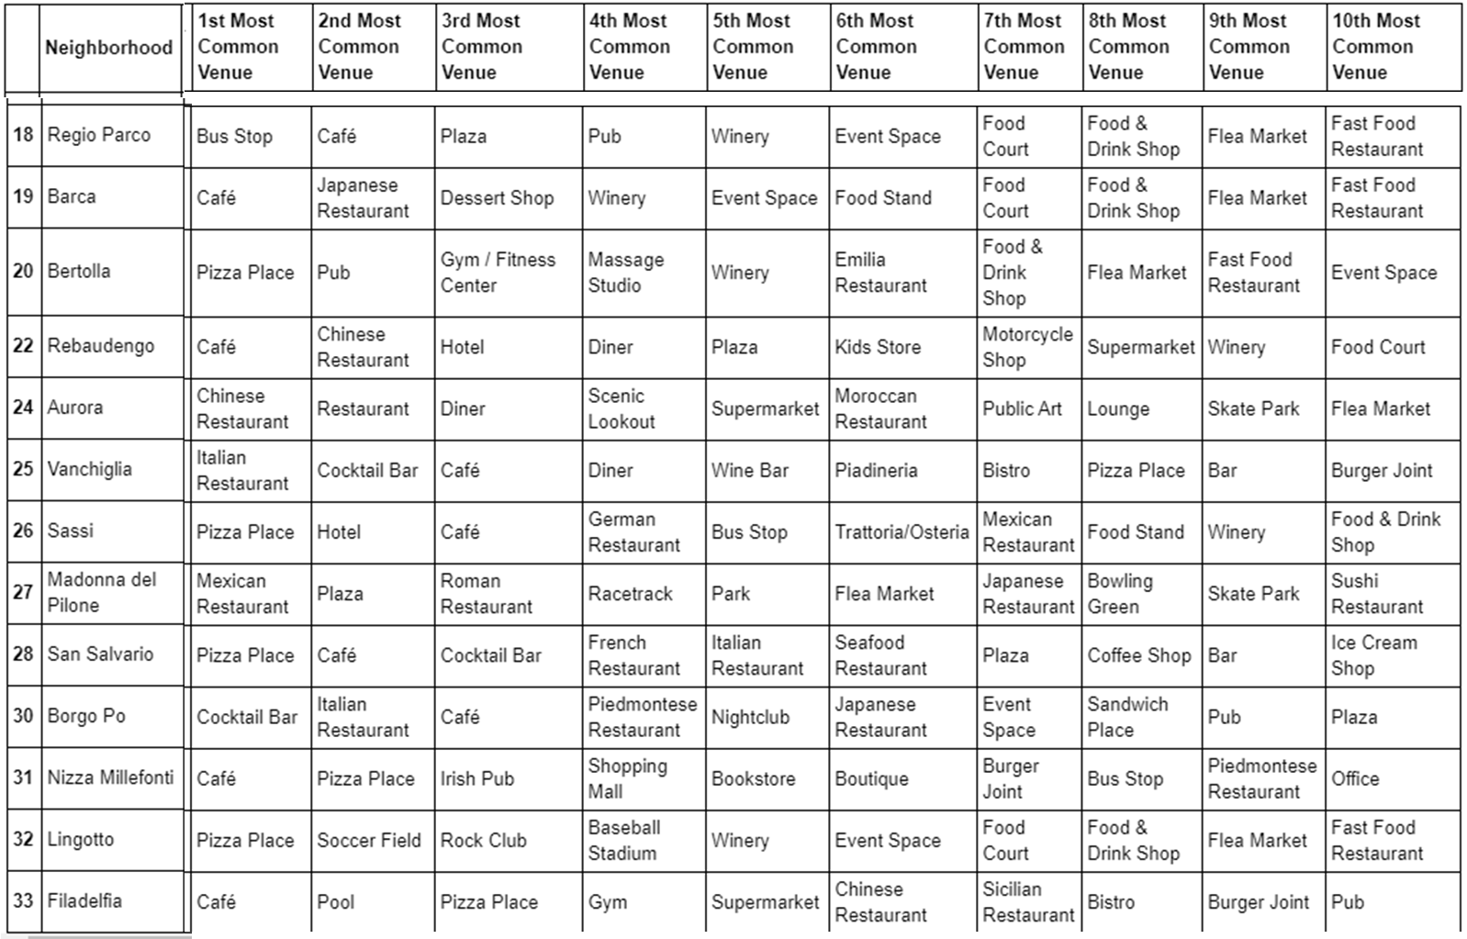
4. Results
Cluster 2

Slide 10
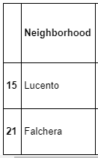
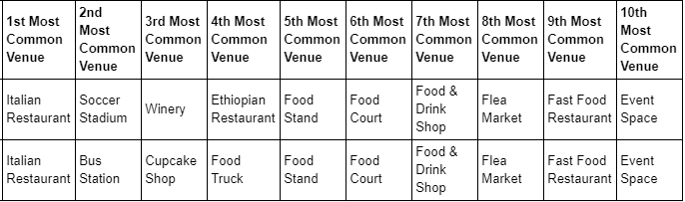
4. Results
Cluster 3

Slide 11
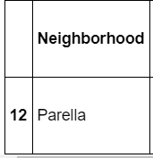
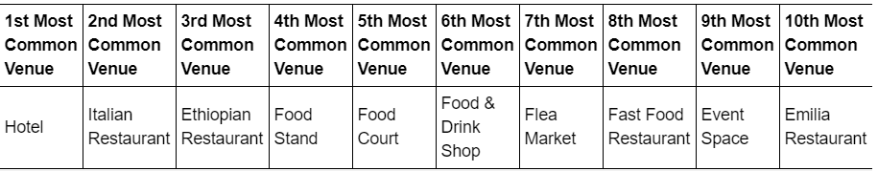
4. Results
Cluster 4

Slide 12
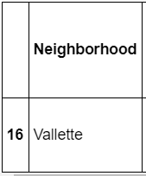
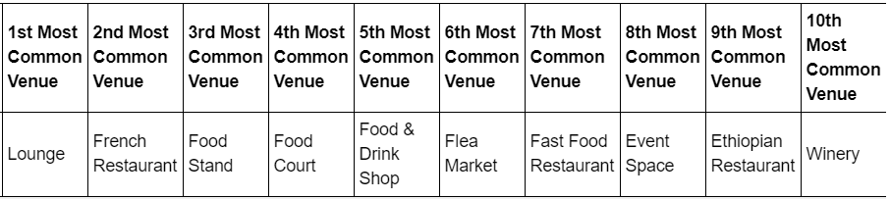
4. Results
Cluster 5

Slide 13
4. Results
Examining Clusters, it is possible to notice that resturants are very popular in Turin.
There are many categories that contain the word "Resturant", such as "Sushi Restaurant, Asian Restaurant, Piedmontese Resturant".
The cluster where Resturants are less popular is the second cluster.

Slide 14
5. Discussion
I would open a restaurant in one of the neighboroods clustered in the 2nd cluster.
Particularly, I would choose one of the following neighborhoods:
Regio Parco
Lingotto
In fact, in these neighborhoods most common venues from 1st to 9th do not contain the word "Restaurant” (see next slide), so competition with other restaurants can be avoided.

Slide 15
5. Discussion

Slide 16
6. Conclusion
I recommend the stakeholders to spend in one of these neighborhoods their money, because here there would be less competition.
To choose between these two neighborhoods further elements could be considered, such as how far they are to the center and how many turists' attractions are there,
but the analysis of these elements is beyond the scope of this excercise, so this analysis is left to future analysis.

Slide 17
Thank You!

